Slide 1
Next word prediction using Java programming

Slide 2
Abstract
Next word prediction can speed up typing and improve the flow of conversation, especially on mobile devices with touchscreen keyboards
Next word prediction using AI involves training a model on large text corpora to learn patterns and relationships between words. This project utilizes techniques such as recurrent neural networks (RNNs), long short-term memory (LSTM) networks, and word embeddings to build a predictive model.
The system preprocesses text data, trains the model on historical data, and then generates predictions based on the input sequence.
Next word prediction using AI holds significant promise in improving user experience across various text-based applications

Slide 3
Introduction
Next word prediction is a fascinating application of artificial intelligence (AI) that aims to predict the next word in a sequence of text based on the preceding words. It finds application in various domains such as text messaging, auto-completion in search engines, and language translation. The goal is to enhance user experience by providing accurate and contextually relevant suggestions for the next word.

Slide 4
Text Based Applications
Messaging Apps
Email Clients
Text editors
Search engines
Social platforms

Slide 5
Role of Next Word
The role of next word in next word prediction is crucial for improving text input experiences across various applications such as keyboards on mobile devices, search engines, and text editors. Next word prediction, also known as predictive typing or autocomplete, utilizes AI algorithms to suggest probable words or phrases that a user is likely to type next based on the context of the current text input.

Slide 6
Proposed System
The proposed next word prediction system aims to address the challenges of accuracy, efficiency, and adaptability. Here's an outline of the key components and functionalities.
Data Collection and Preprocessing
Feature Engineering and Representation
Model Selection and Training
Prediction Generation
Integration and Deployment
User Feedback and Adaptation
Evaluation and Performance Metrics
Scalability and Maintenance

Slide 7
Objective
The objective of this project is to develop an efficient next word prediction system using AI techniques. By leveraging machine learning algorithms and natural language processing (NLP) models, the system aims to accurately predict the next word in a given text sequence, thereby improving user productivity and enhancing text input interfaces.

Slide 8
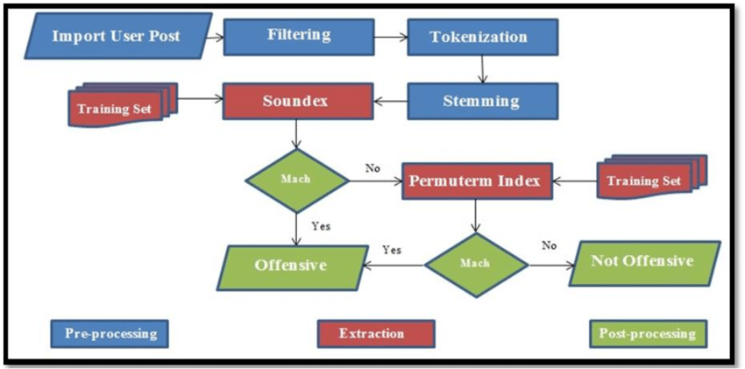
Architecture

Slide 9
Data Collection and Preprocessing: Gather a large dataset of text data from various sources. Preprocess the data to clean it and prepare it for training. This may involve steps like tokenization, lowercasing, removing punctuation, and filtering out irrelevant or noisy data.
Feature Extraction: Extract features from the preprocessed text data that will be used as input to the AI model. These features typically include word embeddings or numerical representations of words and phrases that capture semantic and syntactic information.
AI Model Selection: Choose a suitable AI model architecture for next word prediction. Common options include recurrent neural networks (RNNs), long short-term memory networks (LSTMs), gated recurrent units (GRUs), or transformer-based models like GPT (Generative Pre-trained Transformer).

Slide 10
Problem Statement
The main challenge in next word prediction is to develop a model that can accurately capture the semantics and context of the input text. Ambiguities, variations in language usage, and the diversity of vocabulary pose significant hurdles. Additionally, the prediction system must be fast and efficient to provide real-time suggestions without noticeable latency.

Slide 11
Future Scope
Improved Models: Continuously refining and optimizing the predictive model using advanced neural network architectures and training techniques.
Multimodal Prediction: Integrating other modalities such as images or user context to enhance prediction accuracy.
Real-time Feedback: Incorporating user feedback to adapt and personalize the prediction model over time.
Deployment on Mobile Devices: Optimizing the model for deployment on mobile devices to provide efficient and seamless next word prediction in various applications.

Slide 12
Conclusion
Next word prediction using AI holds significant promise in improving user experience across various text-based applications. By leveraging the power of machine learning and NLP techniques, this project demonstrates the feasibility of developing an accurate and efficient prediction system. Continuous research and development in this area will lead to further enhancements, making next word prediction more intuitive and effective in assisting users with their text input needs.

Slide 13
PROGRAM:
import java.io.BufferedReader; import java.io.FileReader; import java.io.IOException; import java.util.*; public class NextWordPrediction { private Map<String, List<String>> wordMap; public NextWordPrediction() { this.wordMap = new HashMap<>(); } public void trainModel(String filePath) { try (BufferedReader br = new BufferedReader(new FileReader(filePath))) { String line; while ((line = br.readLine()) != null) { String[] words = line.split("\\s+"); for (int i = 0; i < words.length - 1; i++) { String currentWord = words[i]; String nextWord = words[i + 1]; wordMap.computeIfAbsent(currentWord, k -> new ArrayList<>()).add(nextWord); } } } catch (IOException e) { e.printStackTrace(); } }
public String predictNextWord(String currentWord) { List<String> possibleNextWords = wordMap.getOrDefault(currentWord, Collections.emptyList()); if (possibleNextWords.isEmpty()) { return "No prediction available for this word."; } Random rand = new Random(); int randomIndex = rand.nextInt(possibleNextWords.size()); return possibleNextWords.get(randomIndex); } public static void main(String[] args) { NextWordPrediction predictor = new NextWordPrediction(); predictor.trainModel("path/to/your/text/file.txt"); Scanner scanner = new Scanner(System.in); while (true) { System.out.print("Enter a word (or type 'exit' to quit): "); String inputWord = scanner.nextLine(); if (inputWord.equalsIgnoreCase("exit")) { break; } String nextWord = predictor.predictNextWord(inputWord); System.out.println("Predicted next word: " + nextWord); } scanner.close(); } }

Slide 14


